Slide 1



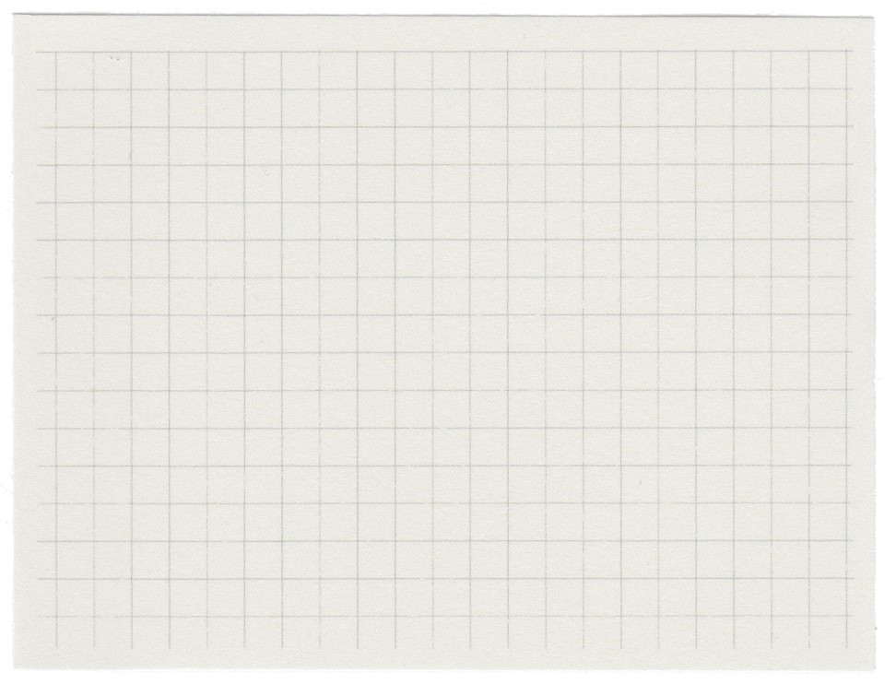



KATA KHAANE
Comp 202 project
Presenters: Ruby Shrestha
Shambhav Rayamajhi
Yogesh Sapkota

Slide 2




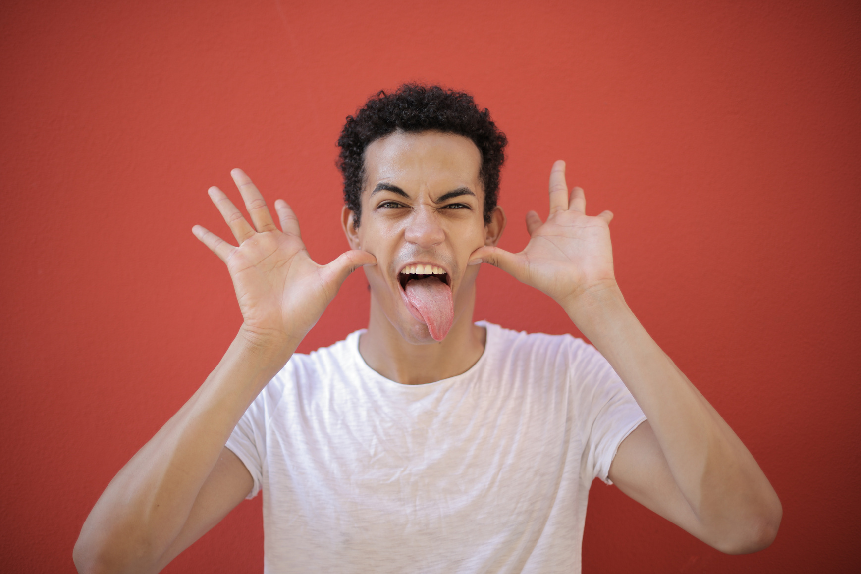
MY TEAM
Ruby Shrestha
23
Shambhav Rayamajhi
18
Yogesh Sapkota
19

Slide 3




THE PROJECT
Description
To avoid lunch time rush hour at KU by showing us the least crowded places one can have their lunch at. By implementation of queues, arrays and sorting algorithms, our project aims to show its users the best possible place to eat if they are looking to save time.

Slide 4


HOW OUR INTERFACE WORKS
Results:
How many of you??
upon which one can view the options readily available
the user enters the no. of seats required
Where are you???
calculates the closest eateries
Booking!!!
the user can choose which place to eat at and book their choice
the user inputs their precise location by left clicking on the map
the algorithm sorts out the closest places you can dine

Slide 5
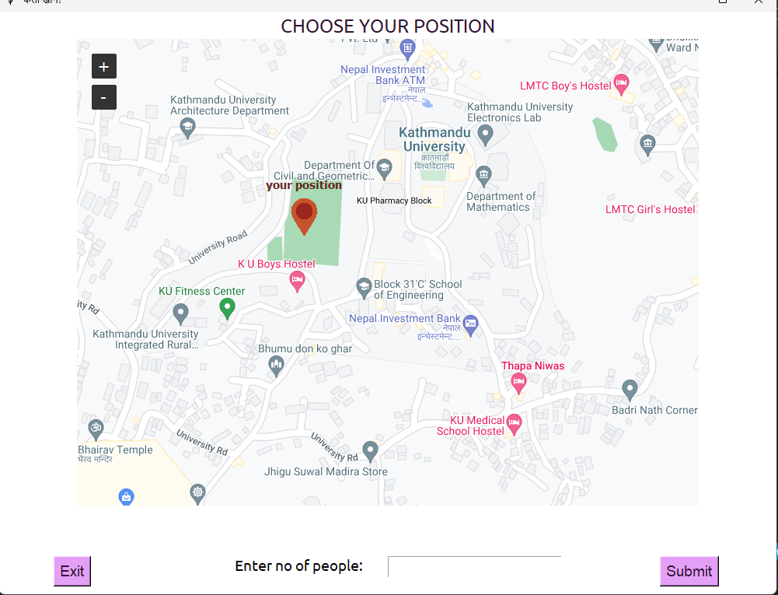



1) choose your location
3) submit
2) enter no. of people

Slide 6
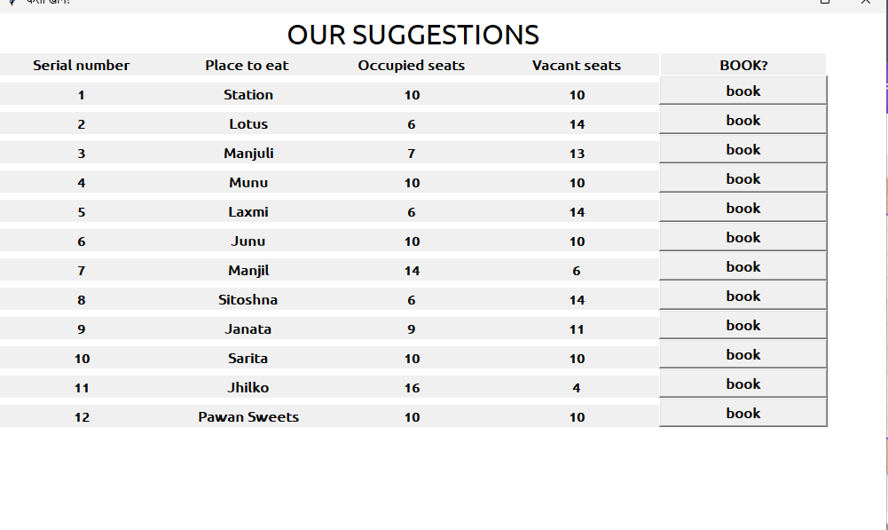
4) book your place

Slide 7
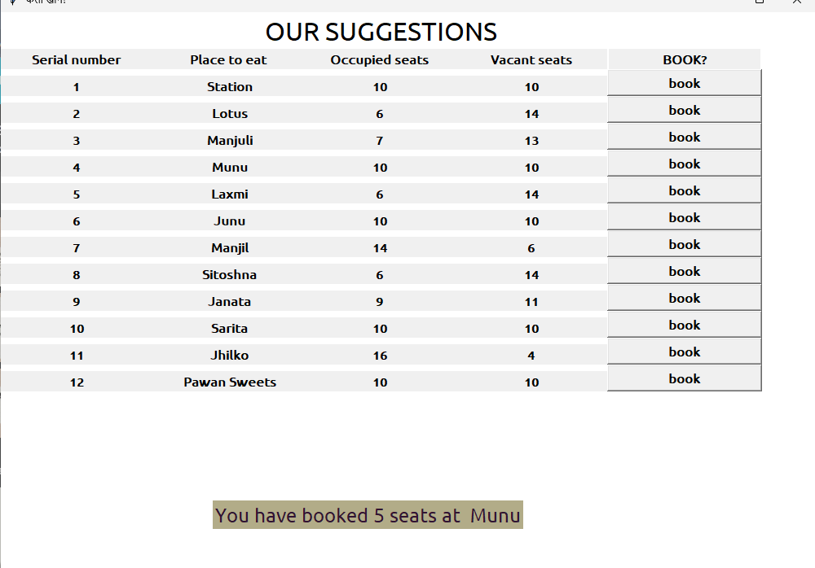


Slide 8

Packages we used in python
tkinter
for GUI
tkintermapview
for viewing map
pandas
for opening a csv file that stores location and its coordinates
random
for generating random number

Slide 9
DATA STRUCTURES AND ALGORITHMS USED
Arrays
Queues
Sorting Algorithm
Since python does not have not have built-in support for arrays, we used python lists as arrays.
We store all the eateries in the array.
We use queues to store the number of seats in each places.
So we set each eatery's seats to 20
To sort the eateries on the basis of distance from the user' s location ,we used quick sort for various reasons we'll be explaining soon.

Slide 10
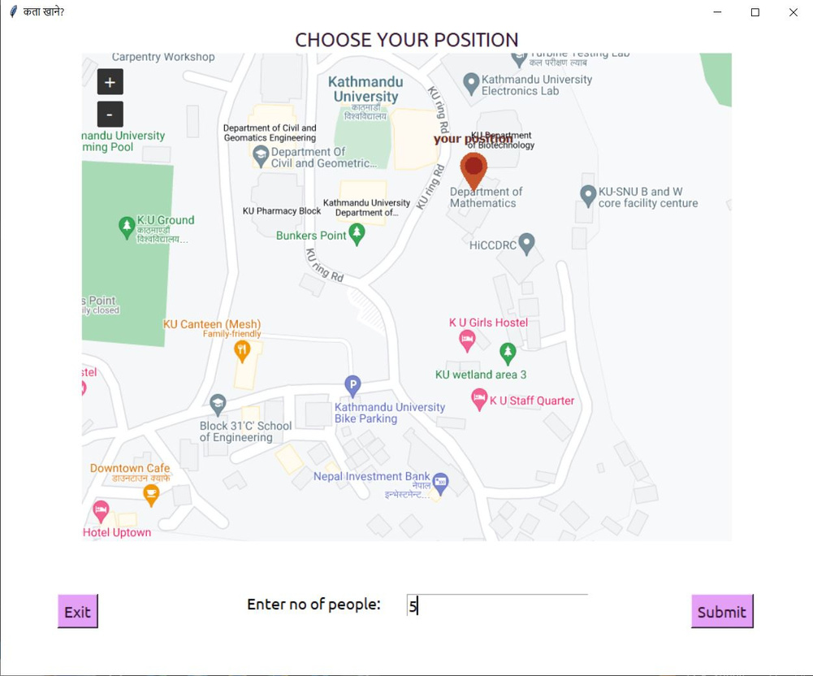
WALKTHROUGH OF OUR CODE
Created a GUI by using Tkinter
package
Takes your position and the
number of people as input.

Slide 11
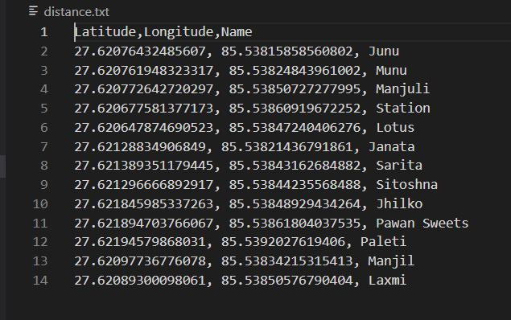
WALKTHROUGH OF OUR CODE
2. Created a CSV file that stores the Name, Longitude, and Latitude of the
diners
This can be read by using pandas.

Slide 12
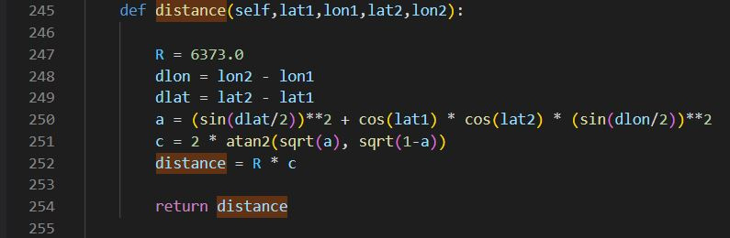
WALKTHROUGH OF OUR CODE
3. Calculated the distance
The distance is based on the user's and the diner's location.

Slide 13
WALKTHROUGH OF OUR CODE
4. Created an array
This stores the diner's name, distance, and the number of seats.
5. The number of seats mentioned above is stored in a queue.
The size of the queue is set to 20. Since this is just a
prototype, we use a random number generator to enqueue.
6. 5. Array is then sorted based on distance
Using quicksort algorithm

Slide 14
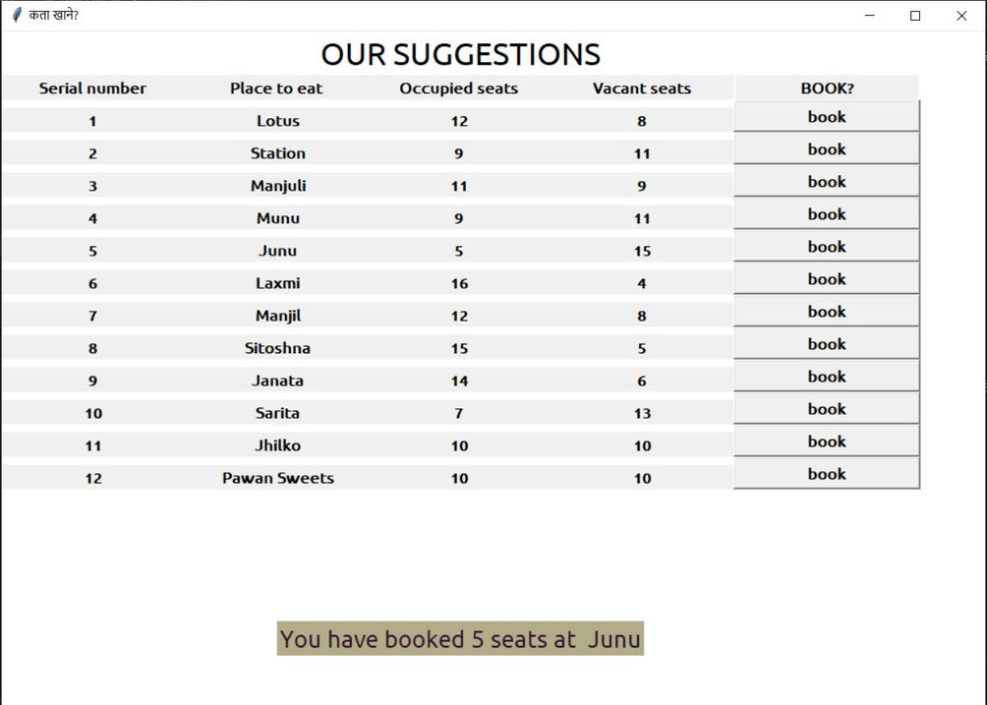
WALKTHROUGH OF OUR CODE
7. The sorted list of diners is listed serially,
along with the occupied and vacant seats
with the option to book.
8. When the "book" button is clicked, the
program effectively shows the place
and the number of seats booked.

Slide 15

Any questions?

